Slide 1



Graduation Project

Slide 2


Human Resources
Analysis

Slide 3

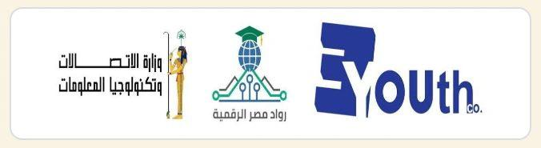

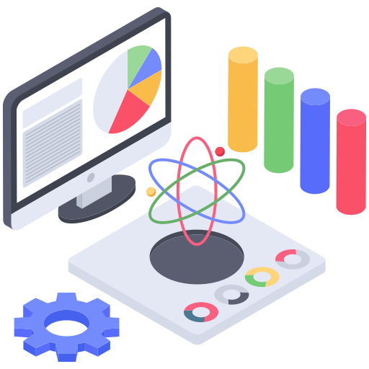



Data Analysis Project Team_DEPI
DEPI_GIZ2_DAT1_S5
Data Dynamos Team
Ahmed Emad Habib | 1
Mohammed Amgd Marzouk | 2
Peter Rafat Adel | 3
Mohammed Elhossiny Abrabo | 4
Zyad Sameh Mohamed | 5
Under Supervision of:
Dr. Sepa Mostafa
Dr. Rami Magdi

Slide 4



Slide 5


About Dr. Seba
I am Sepa, I have a BSc in Science and have been working as a senior data analyst and data analytics trainer for the past 5 years.
I have been working with both global and local companies (Udacity, Orange, Afri Labs, Carerha, … ).
Published a paper on machine learning in an international journal.
Trained over 1000 Students.
Students who graduated got job offers.
Udacity Top-Rated Instructor.
Over 1000 hours of training done.
Dr. Seba Mostafa
Data Analyst
Data Analyst

Slide 6




Meet Our Team
Ahmed Emad Habib
Mohammed Elhossiny Abrabo
Peter Rafat Adel

Slide 7


Meet Our Team
Mohammed Amgd Marzouk
Zyad Sameh Mohamed

Slide 8
Introduction
This project focuses on analyzing the HR data of a company to gain a comprehensive understanding of employee demographics, salary trends, promotions, and work-life factors. By examining key areas such as employee turnover, salary distributions across gender and ethnicity, and correlations between education, marital status, and overtime, the project aims to provide data-driven insights. It will also explore employee-manager relationships through performance ratings and the impact of training opportunities on promotions and salaries. Various statistical methods and visual representations will be used to identify trends and patterns in the data.

Slide 9
Objectives
The primary objective of this project is to conduct a comprehensive analysis of HR data to uncover actionable insights that can improve employee retention, enhance job satisfaction, and optimize workforce performance. By leveraging advanced data analysis techniques and predictive modeling.
Tools: Python, Power BI, Tableau, SQL, Excel, local studio.

Slide 10
Analyze Age and Tenure:
Calculate the average, highest, and lowest employee ages.
Identify the year with the highest employee turnover.
Calculate the average duration employees have been with the company.
Explore the correlation between years at the company and marital status, as well as years at the company and salary.
Examine Salary Distribution:
Analyze salaries based on gender and ethnicity.
Identify the highest-paid department and job role.
Investigate the relationship between marital status and salaries, as well as distance from home and overtime.
Department and Role Analysis:
Determine the department with the fastest promotions.
Assess the average age of employees by state.
Analyze the correlation between work-life balance and marital status.

Slide 11
Performance and Promotions:
Examine the relationship between manager ratings and promotions.
Calculate the difference between self-ratings and manager ratings.
Evaluate the correlation between training opportunities taken and salaries or promotions.
Visualize Employment Trends:
Use a line chart to display hire dates by employee count.
Present marital status distribution with a pie chart, highlighting any correlation with salaries and overtime.

Slide 12
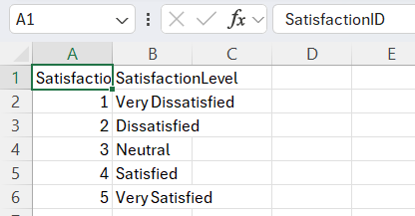
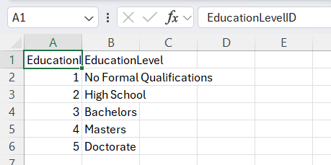
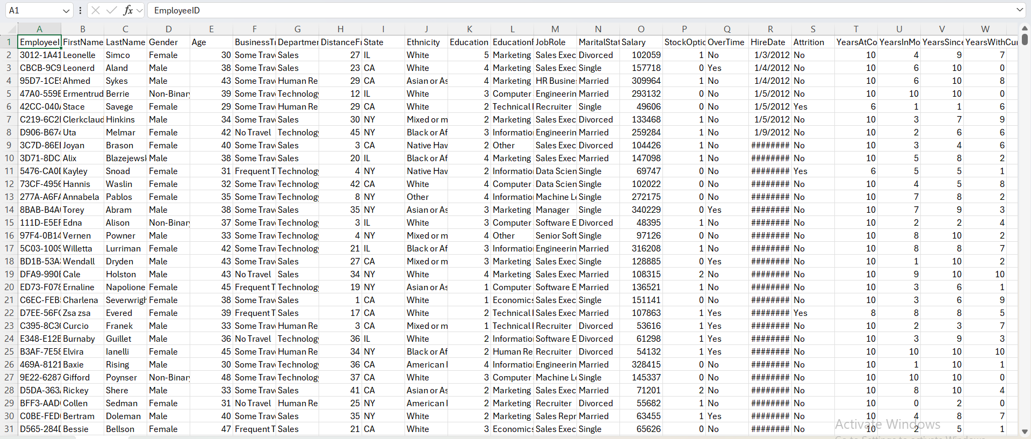
Data Collection
Data Sources:
Employee demographics (Gender, Age, Ethnicity, Marital Status).
Job details (Department, DistanceFromHome, BusinessTravel, HireDate).
Performance and tenure (PerformanceRating, YearsAtCompany, YearsSinceLastPromotion).
Compensation (Salary, StockOptionLevel).
Other factors (OverTime, Attrition).

Slide 13
Data Wrangling
Merging Datasets:
Handling Nested Data:
Key Output:
Combined Employee, PerformanceRating, and EducationLevel datasets.
Used data explosion techniques to analyze nested data.
Clean, merged dataset ready for analysis.

Slide 14
Data Cleaning & Processing
Handling Missing Values:
Removed or imputed missing data.
Correcting Errors:
Fixed inconsistencies in data formats.
Removing Duplicates:
Ensured data integrity by removing duplicate records.
Standardizing Formats:
Normalized data for consistency.

Slide 15
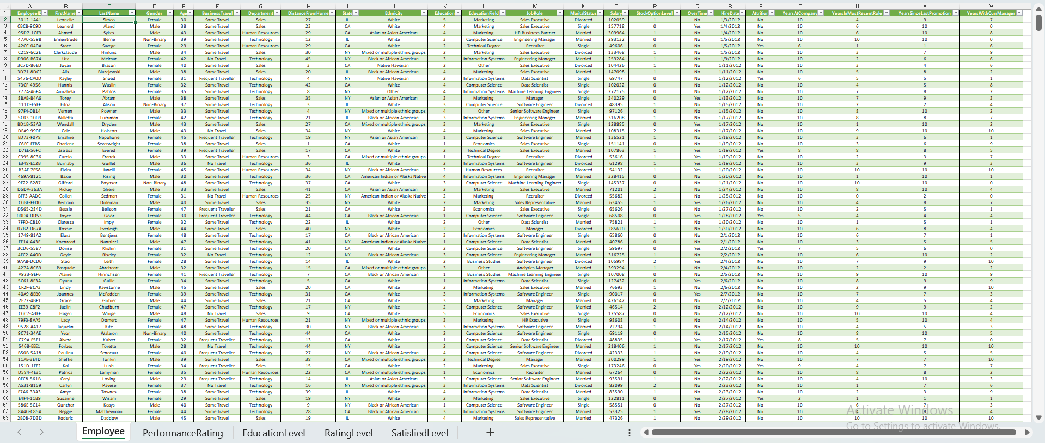
Data cleaning

Slide 16
Data Exploration & Transformation
Exploratory Data Analysis (EDA):
Analyzed data distribution, patterns, and relationships.
Data Transformation:
Created new variables (e.g., tenure groups, age groups).
Visualizations:
Used histograms, scatter plots, and box plots to understand data.

Slide 17

Key Insights
Business Questions

Slide 18
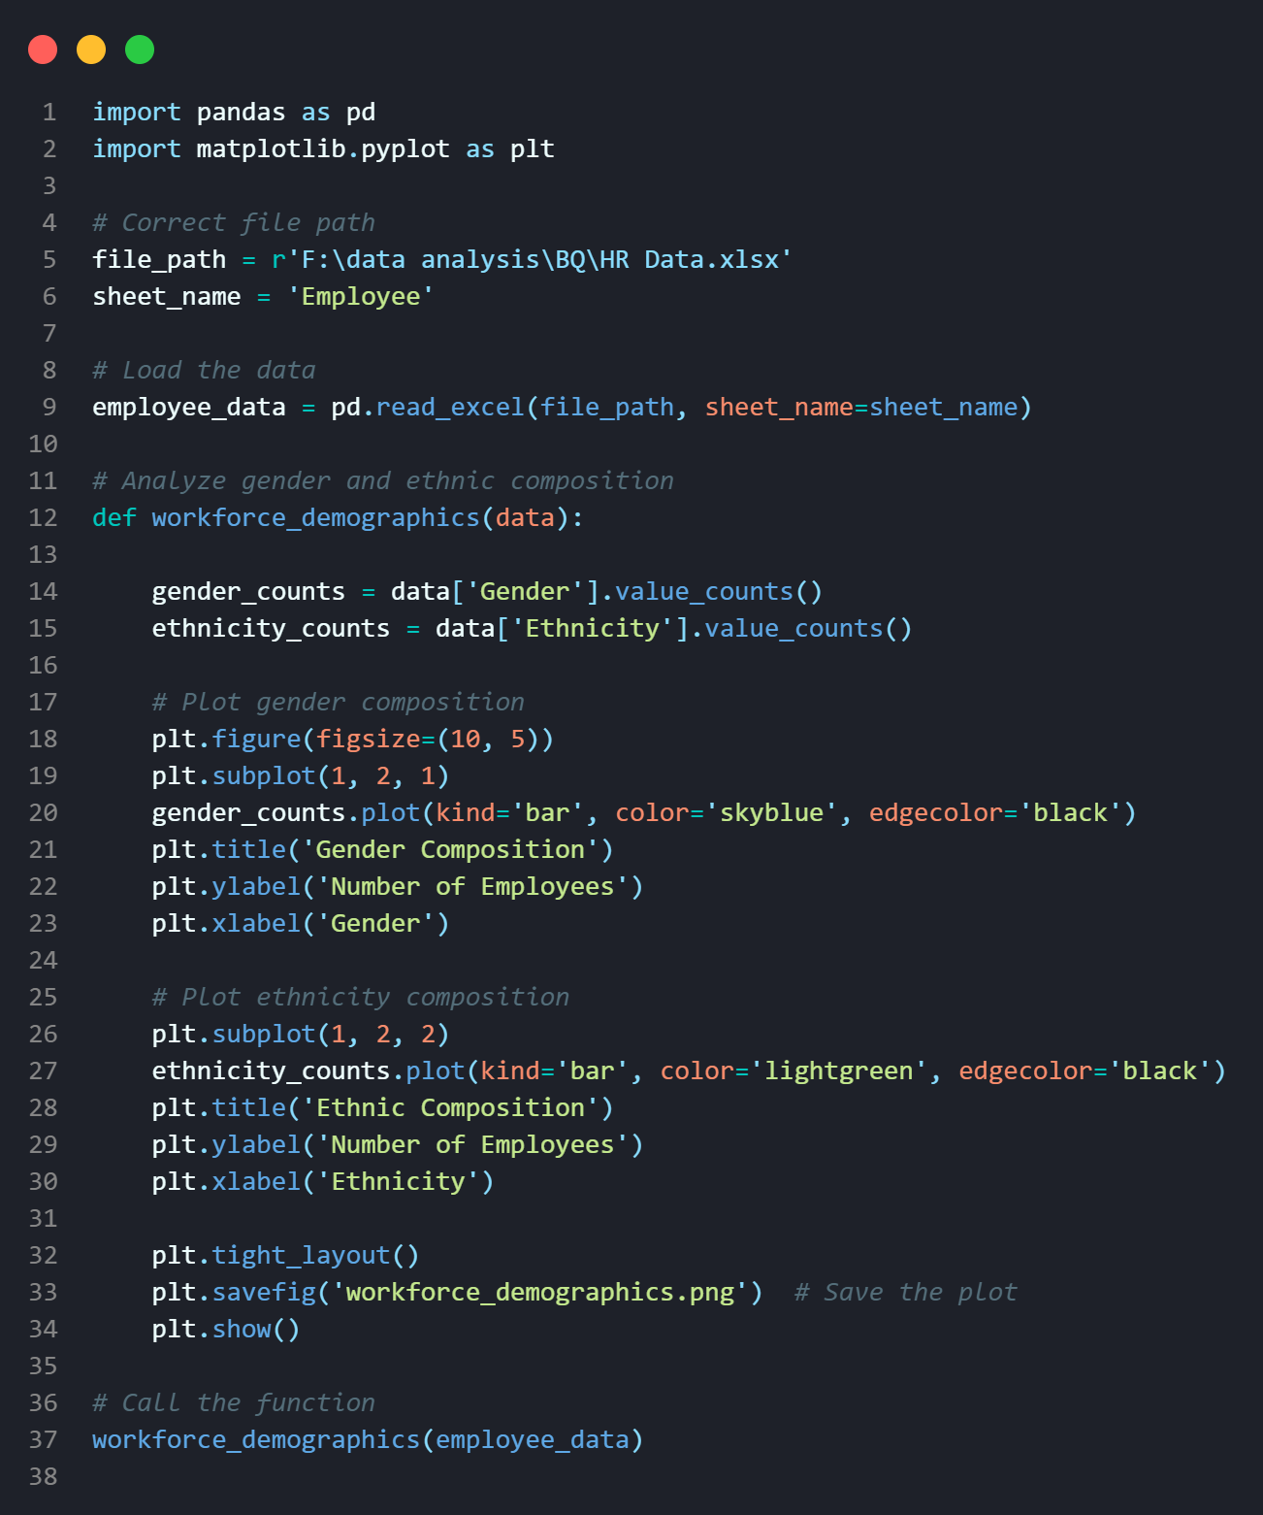
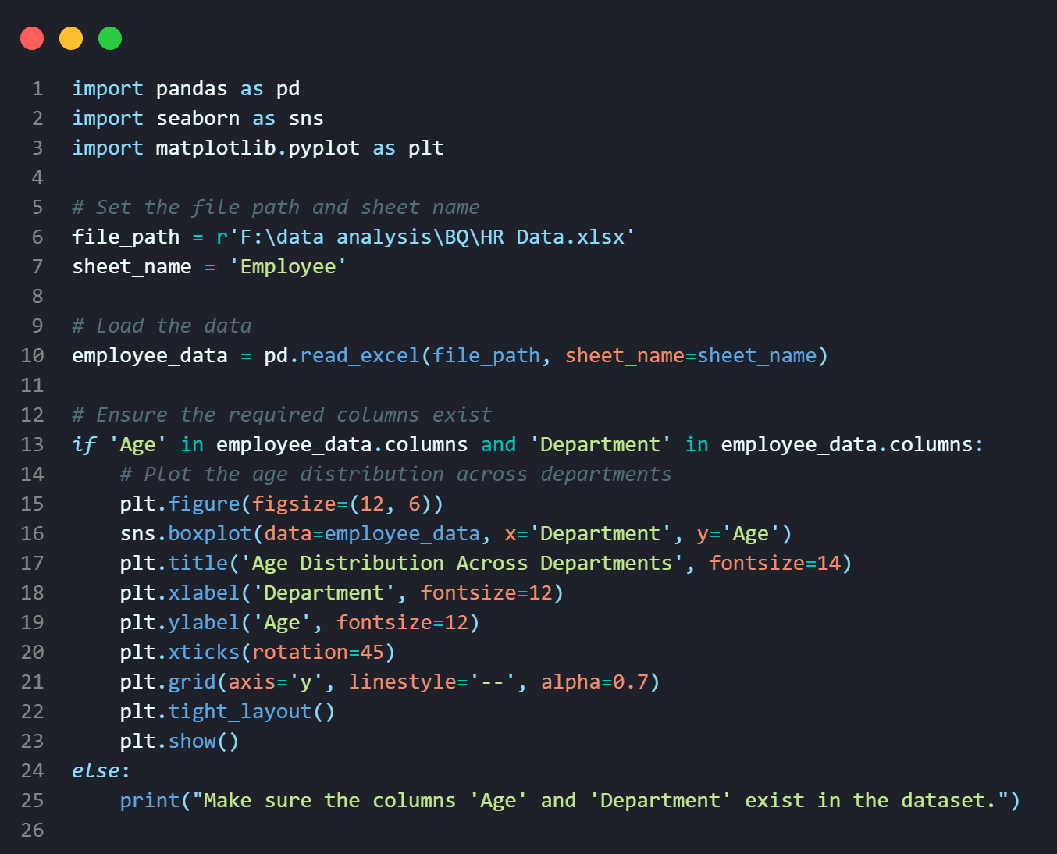
Key Insights
Workforce Demographics

Slide 19
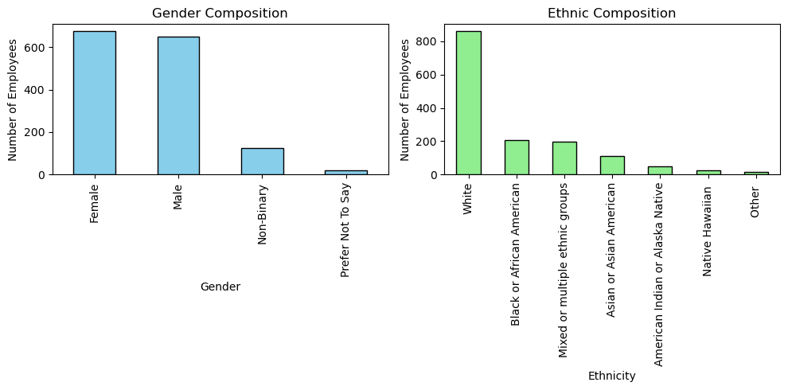
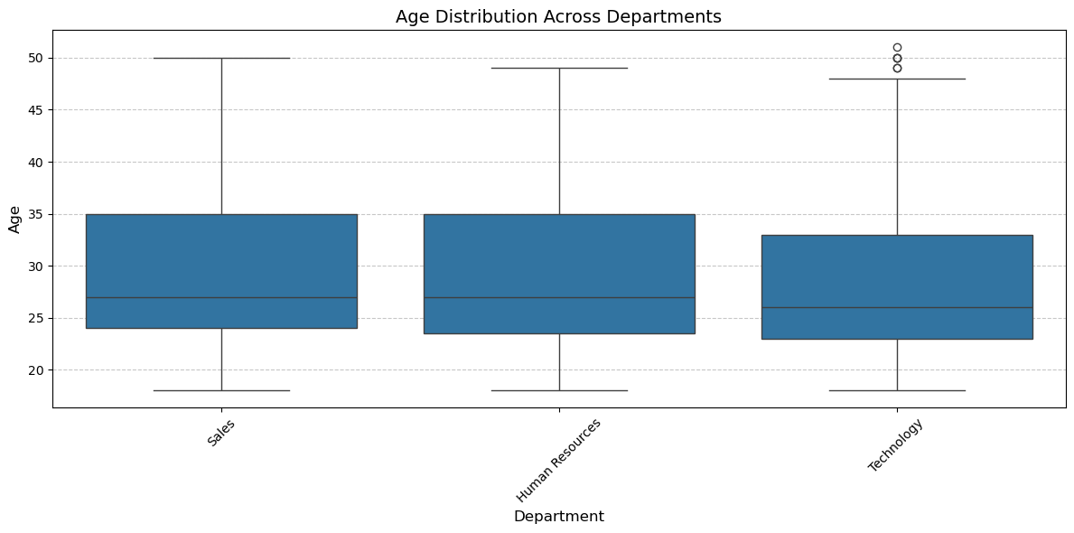
Key Insights
Workforce Demographics

Slide 20
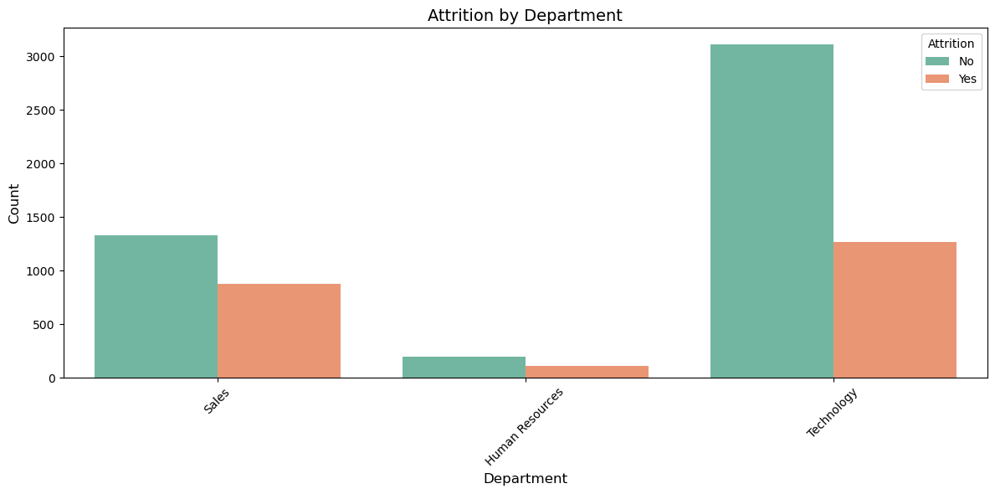
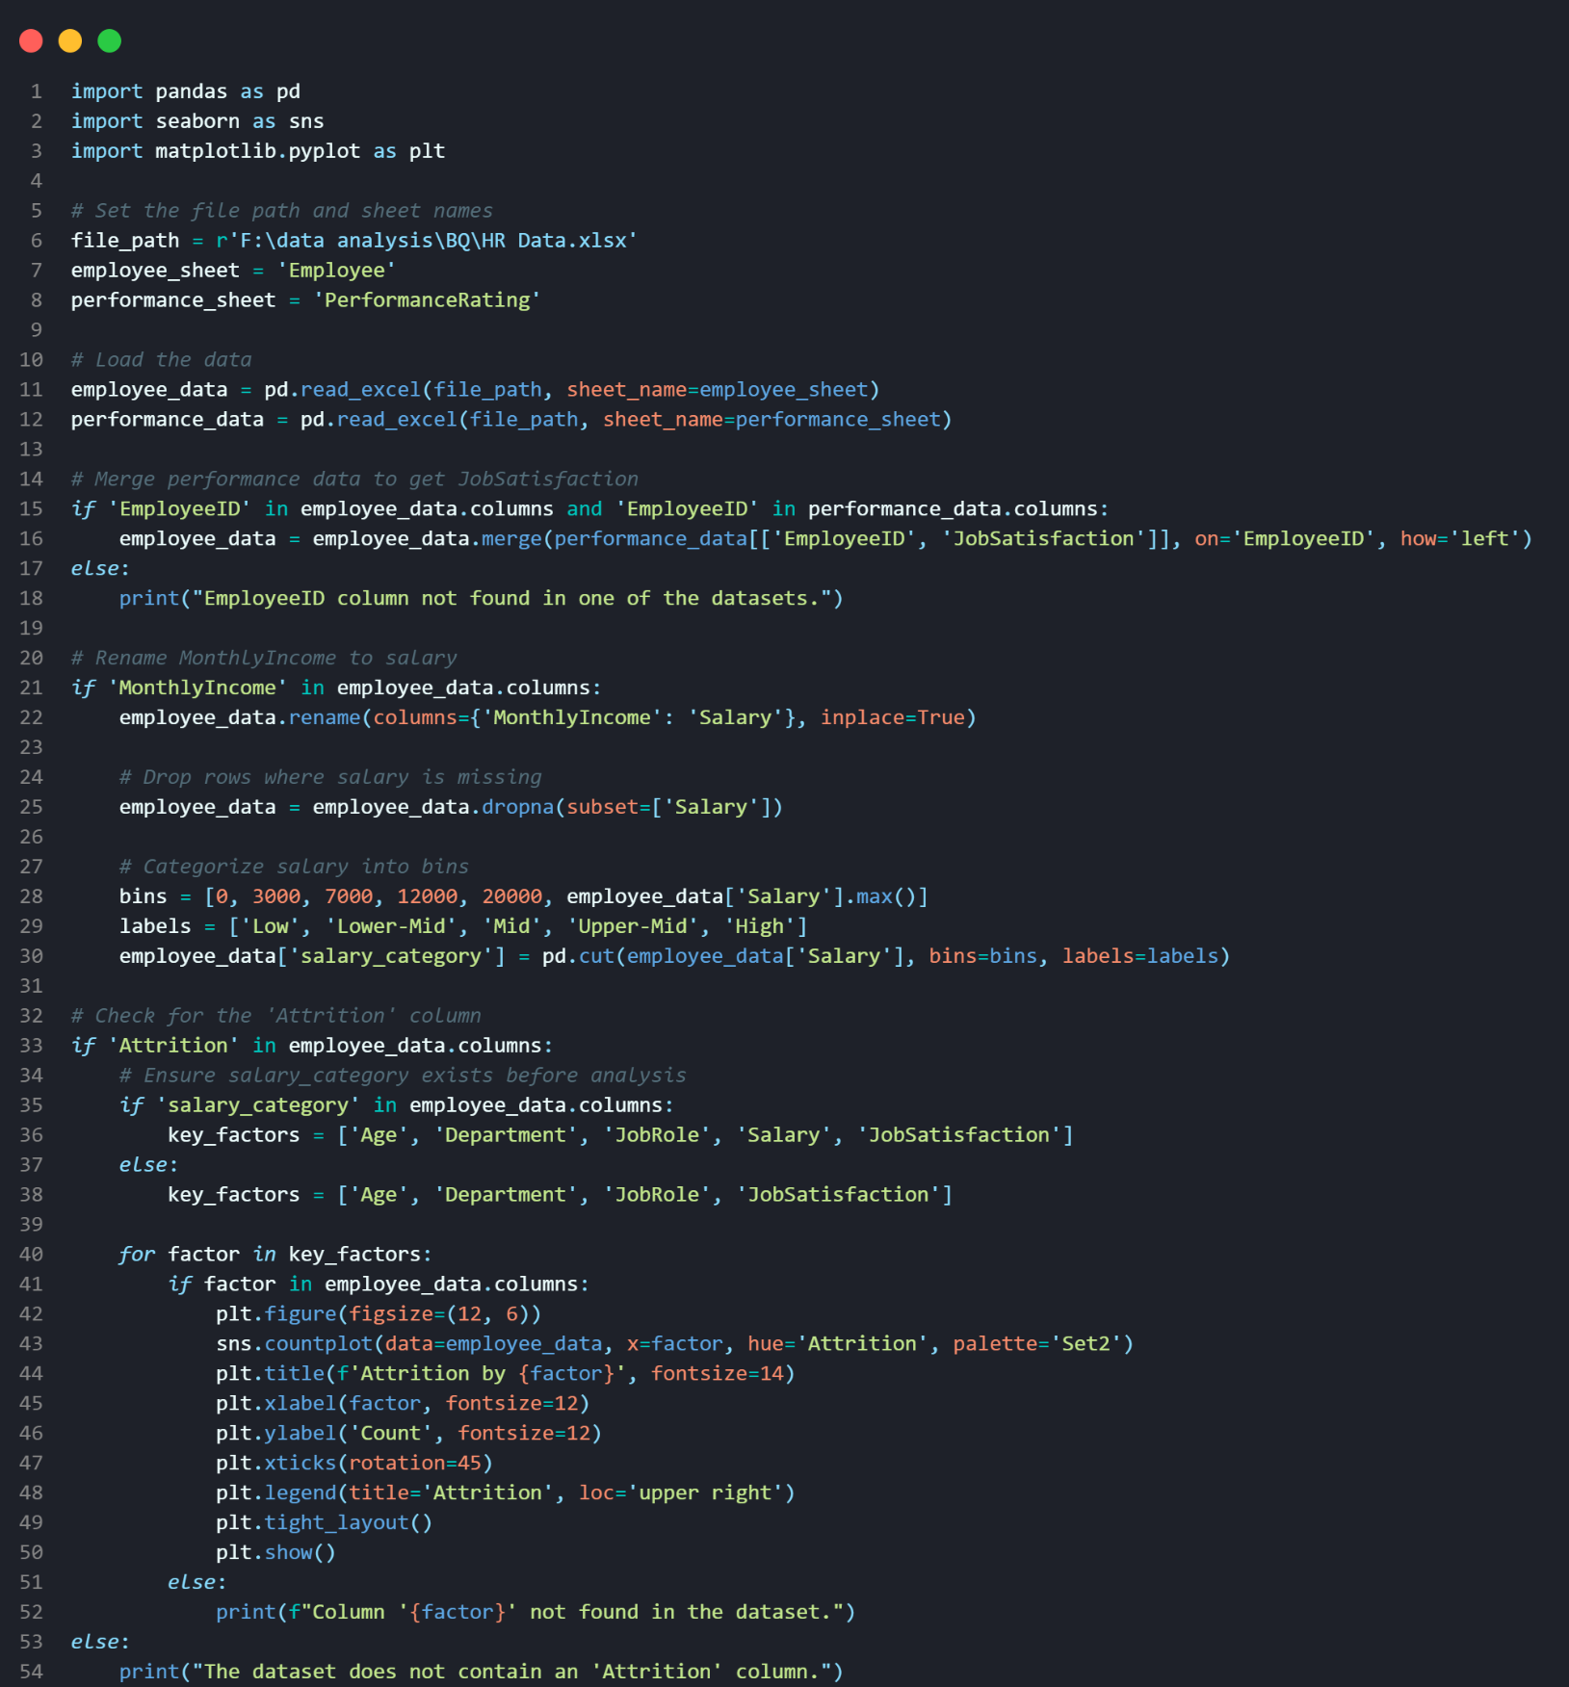
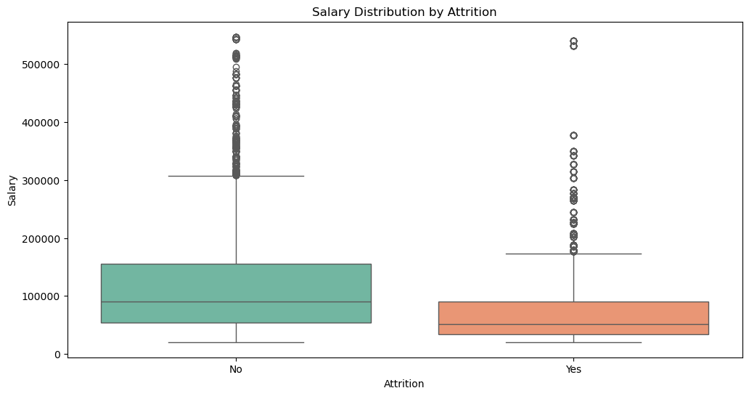
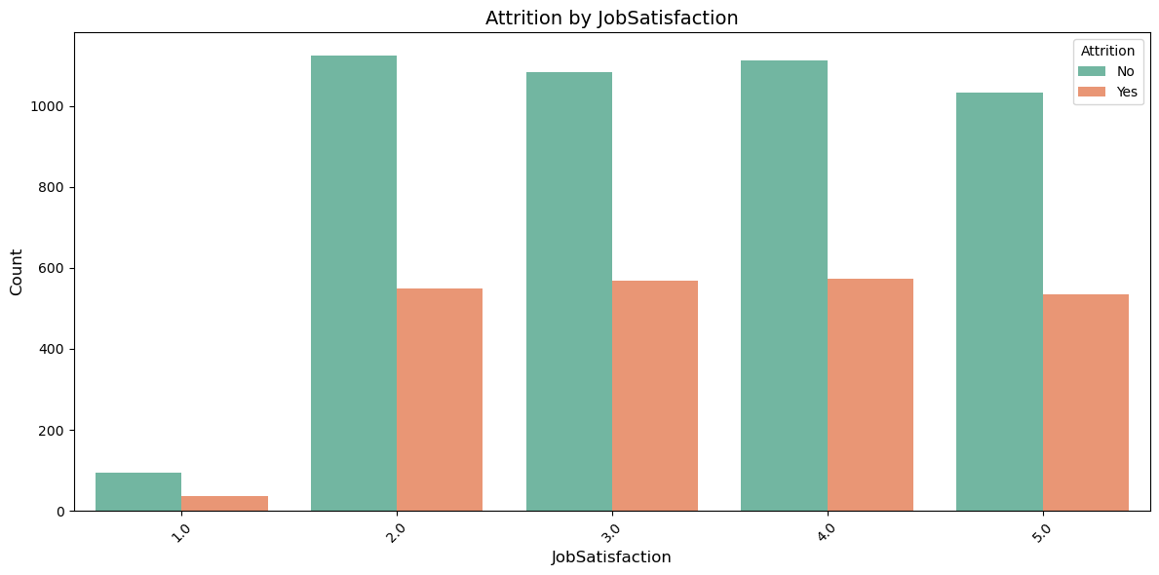
Key Insights - Employee Attrition

Slide 21
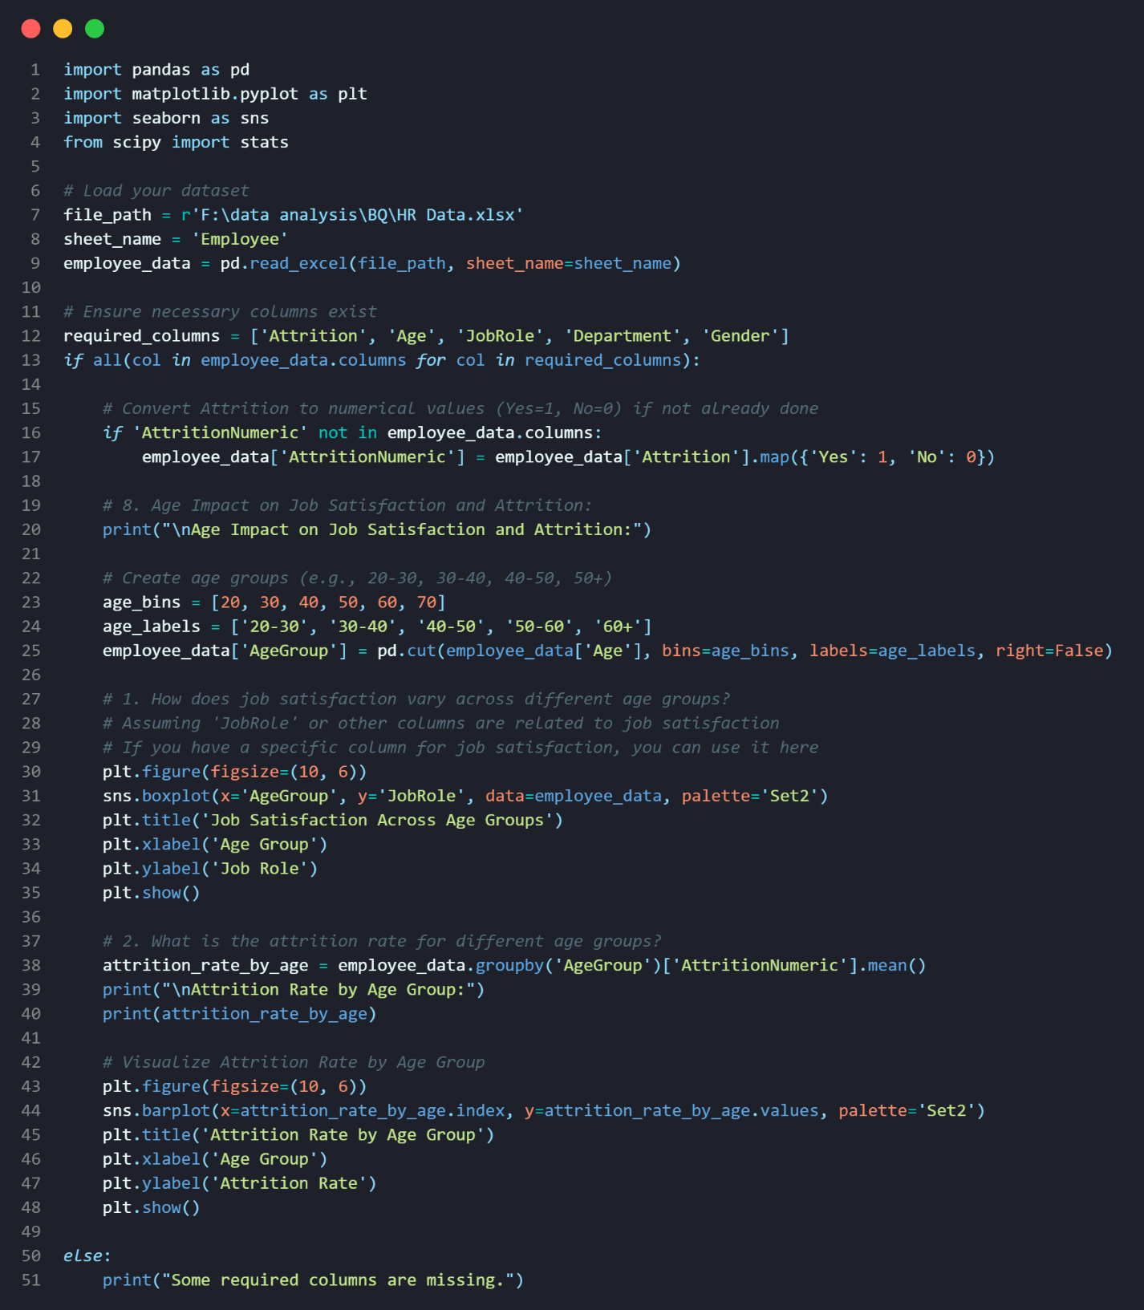
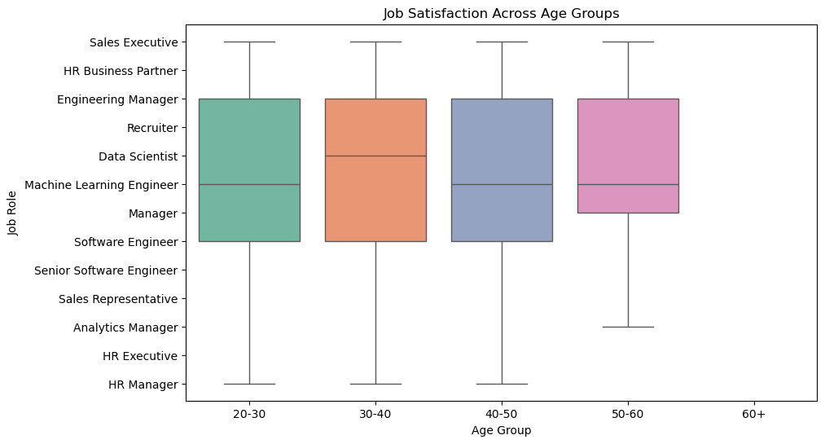
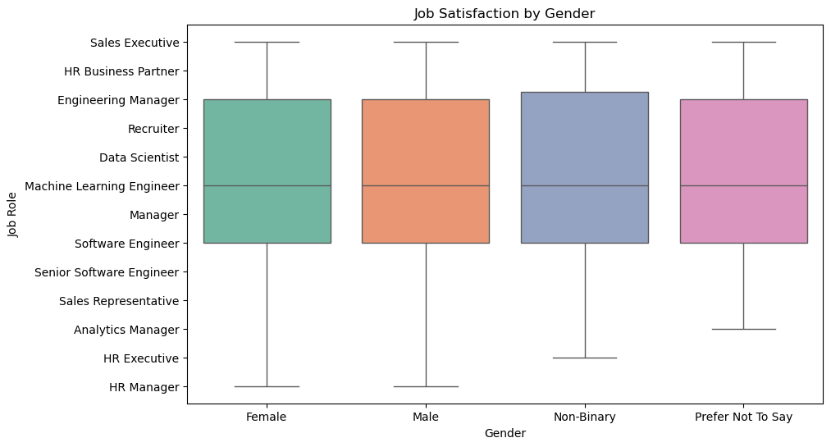
Key Insights - Performance & Satisfaction

Slide 22
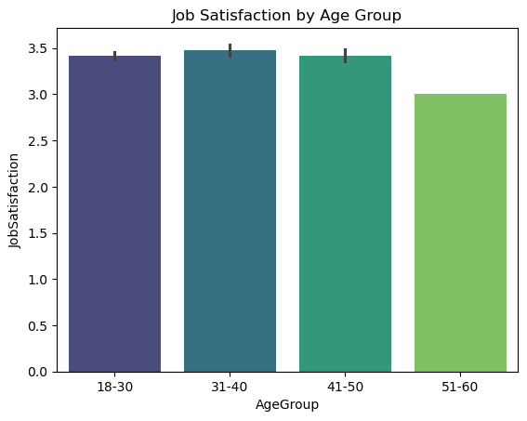
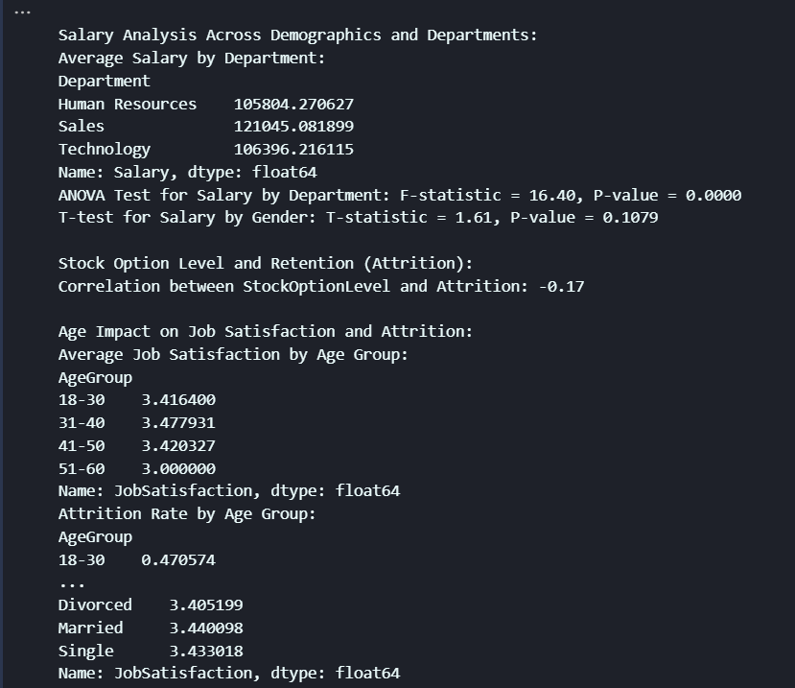
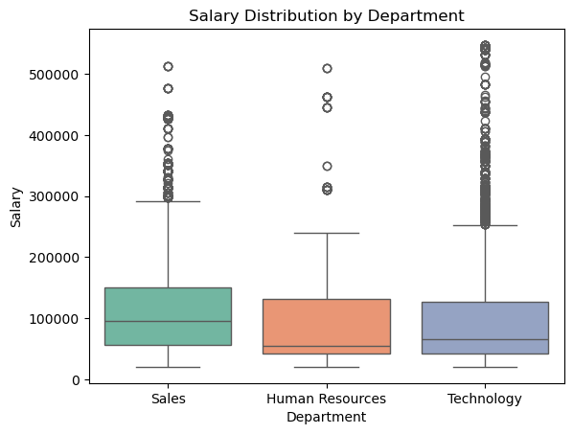
Key Insights - Compensation Analysis

Slide 23
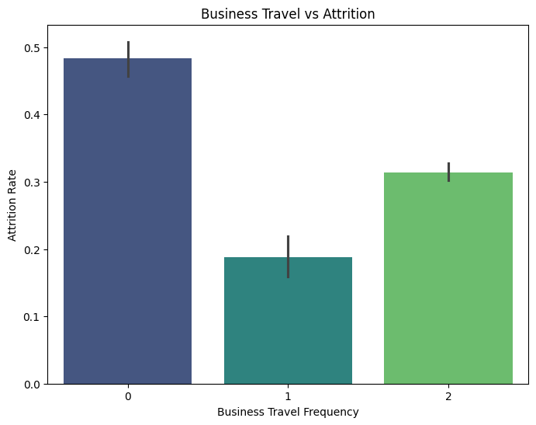
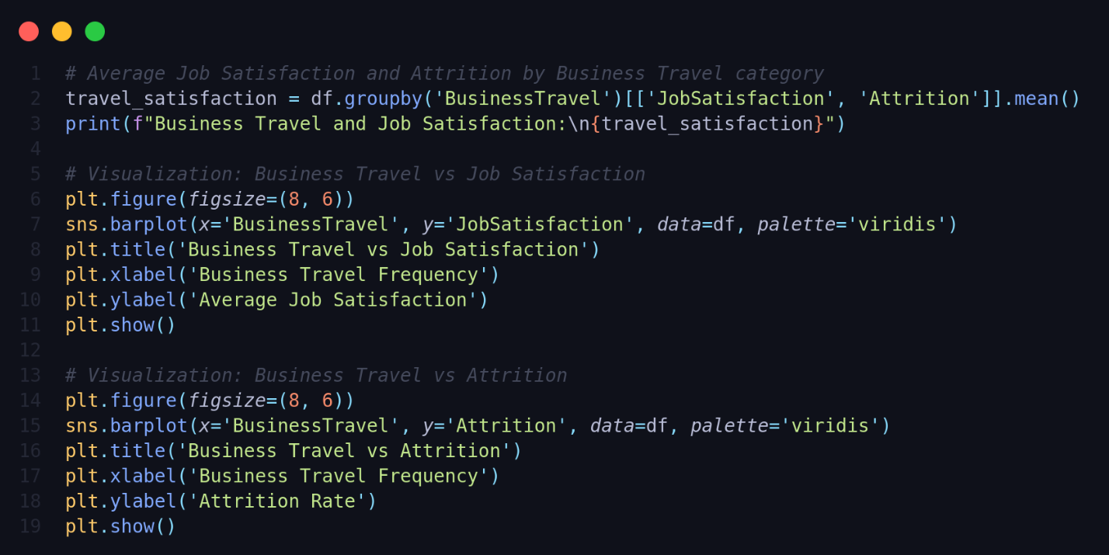
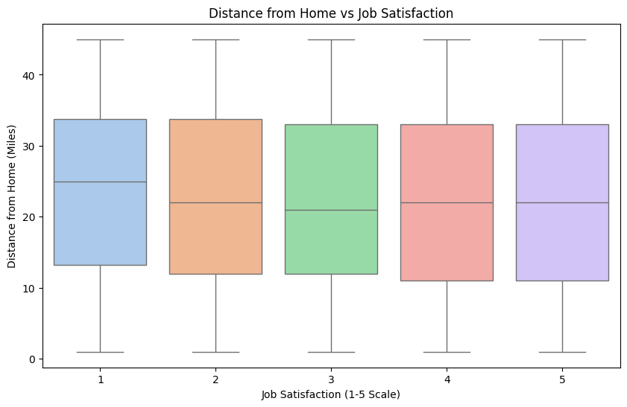

Key Insights - Geographic Insights

Slide 24
Data Modeling
Predictive Analysis

Slide 25
Predictive Analysis
Attrition Prediction:
Performance Prediction:
The model demonstrates strong accuracy in predicting employee attrition.
Key factors influencing attrition include overtime hours, salary levels, and the number of years spent at the company.
Salary, age, and tenure at the company are the most significant factors affecting employee performance, with salary being the most influential.
Promotion Readiness:
Salary Prediction:
Employees with longer tenure and higher manager ratings are more likely to be promoted.
The model estimates salaries by analyzing department, years of experience, and job role, maintaining a reasonable margin of error in its predictions.

Slide 26
Data Forecasting
Future Trends:
New hires show high attrition risk without preventive measures.
Overtime employees face concerning resignation trends.
Hybrid work models effectively reduce turnover and boost satisfaction.

Slide 27
Data Visualization
Tools: Tableau, Power BI & Excel

Slide 28

Data Visualization
Tools: Tableau, Power BI & Excel

Slide 29
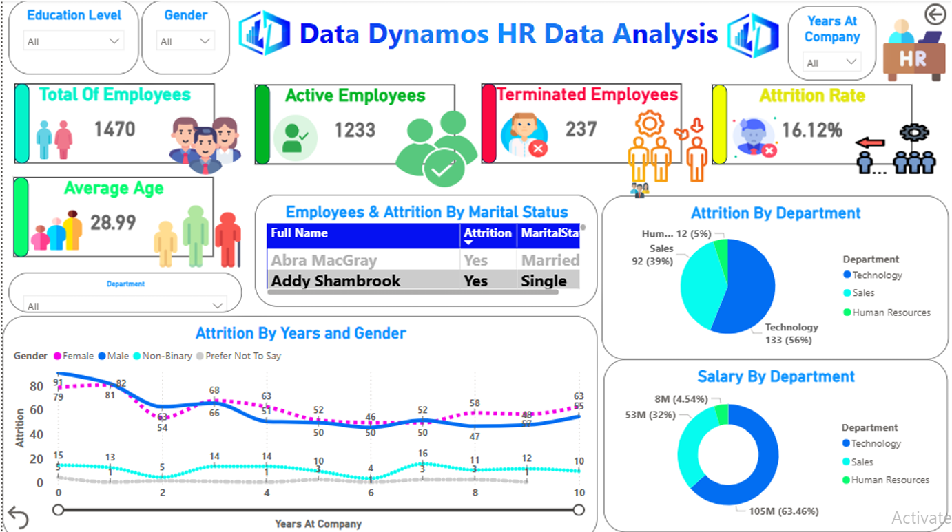
Data Visualization
Power BI for Data Analysis

Slide 30
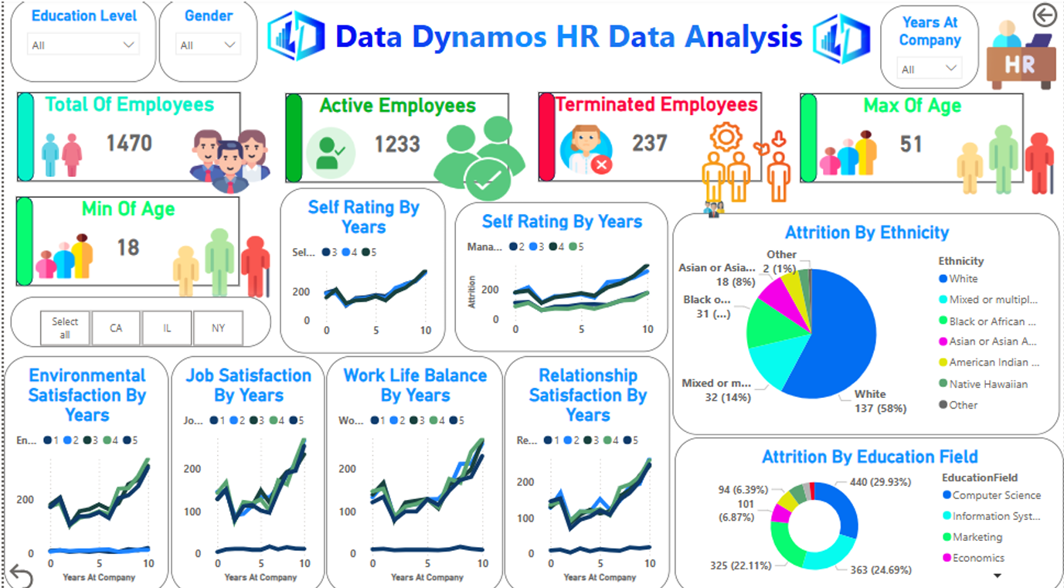
Data Visualization
Power BI for Data Analysis

Slide 31
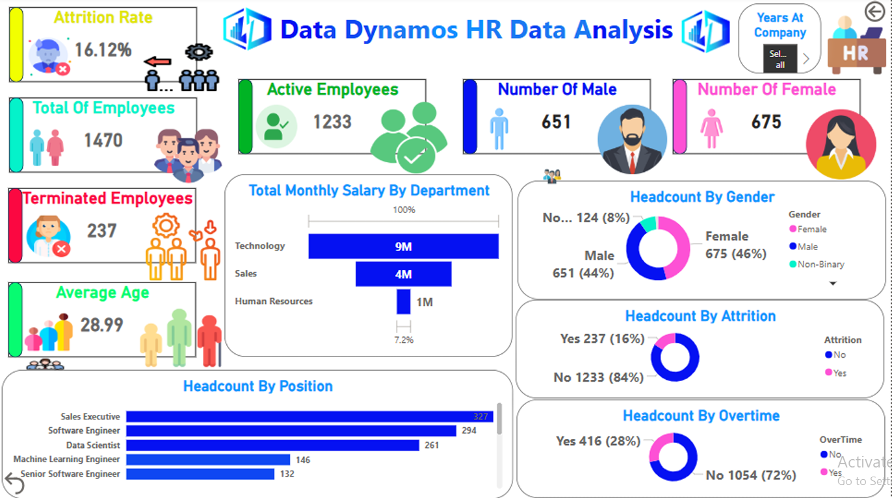
Data Visualization
Power BI for Data Analysis

Slide 32
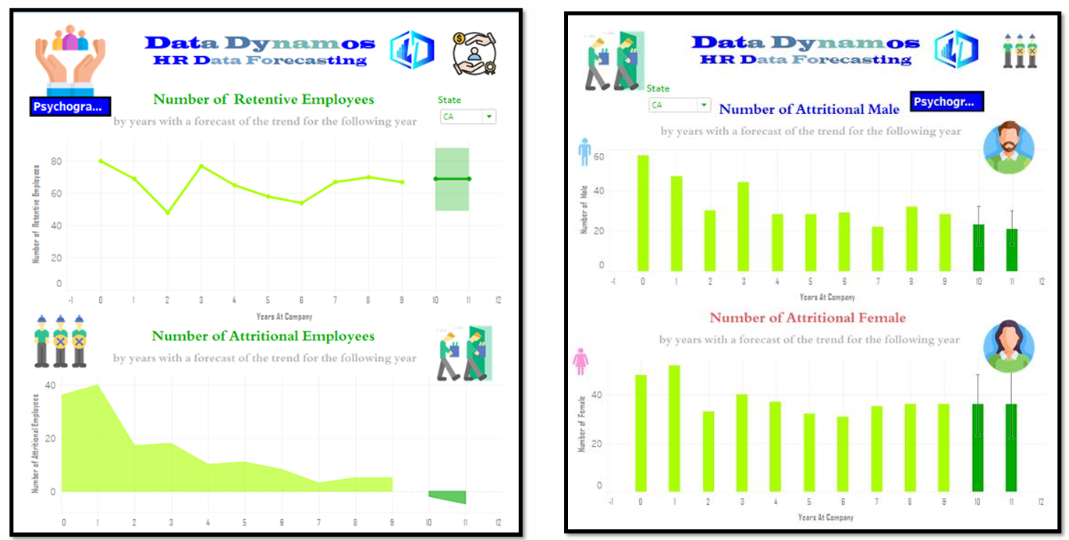
Data Visualization
Tableau for Data Forecasting

Slide 33
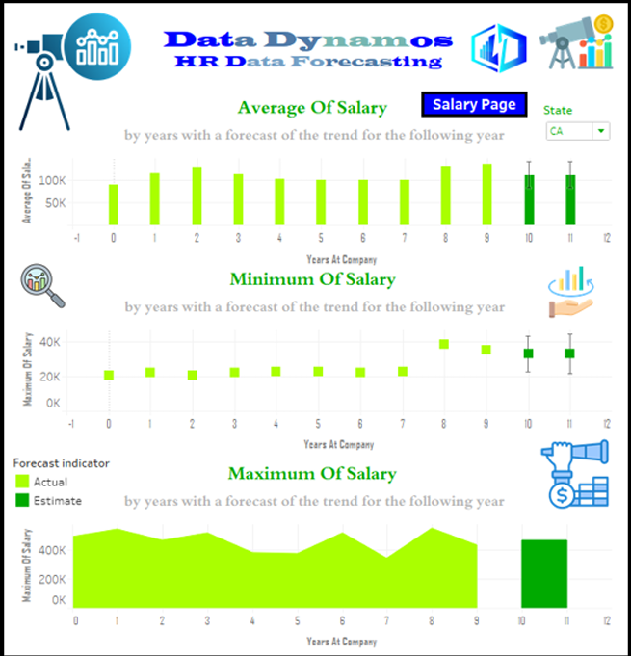
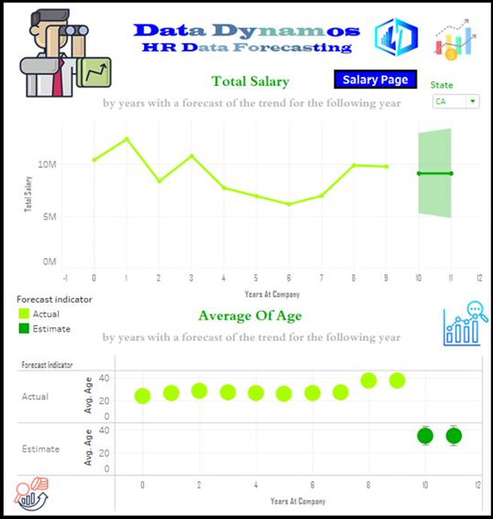
Data Visualization
Tableau for Data Forecasting

Slide 34
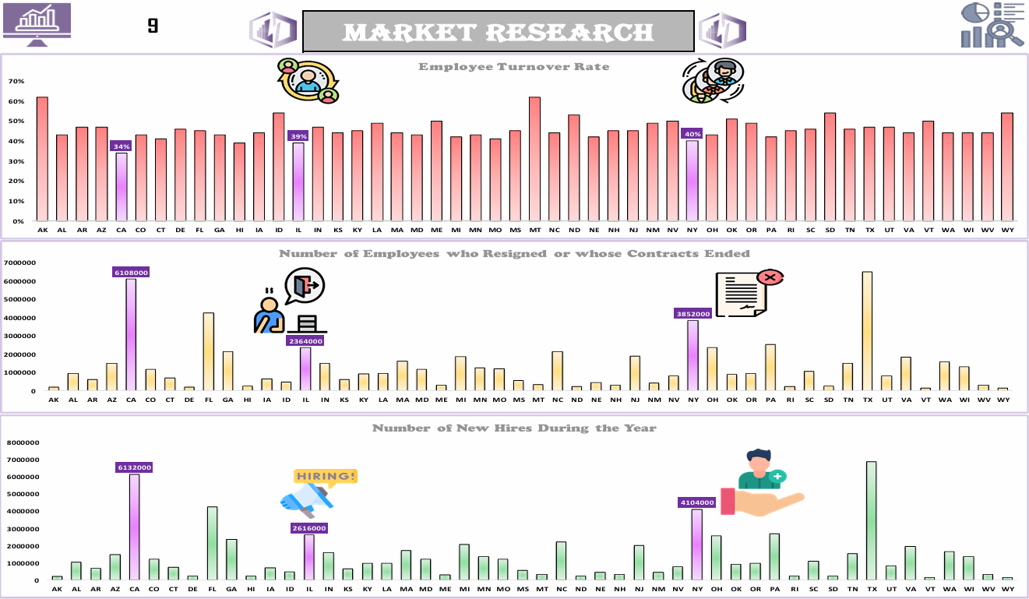
Data Visualization
excel for marketing research

Slide 35

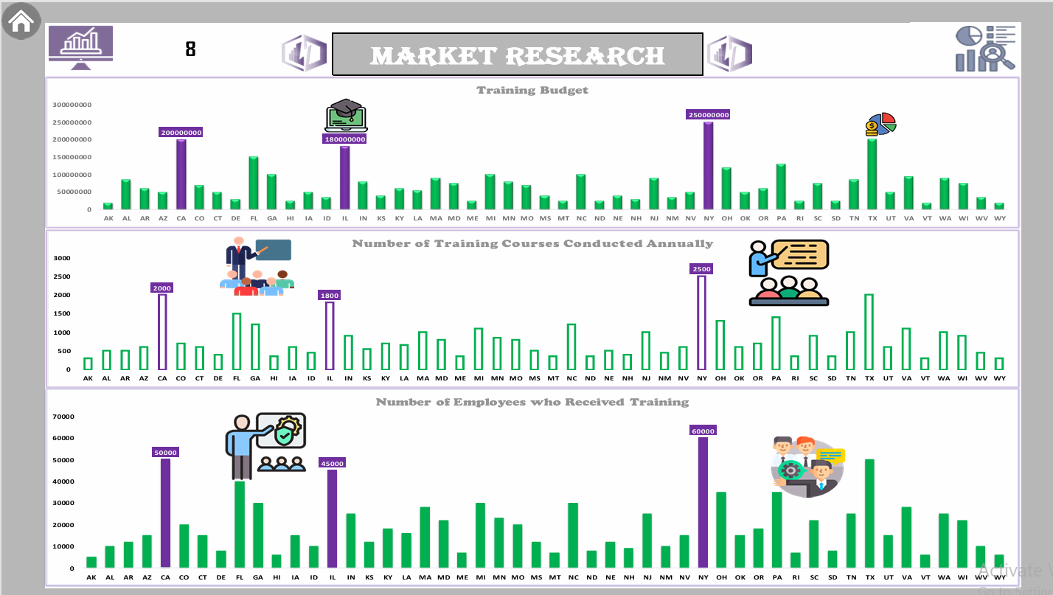

Slide 36
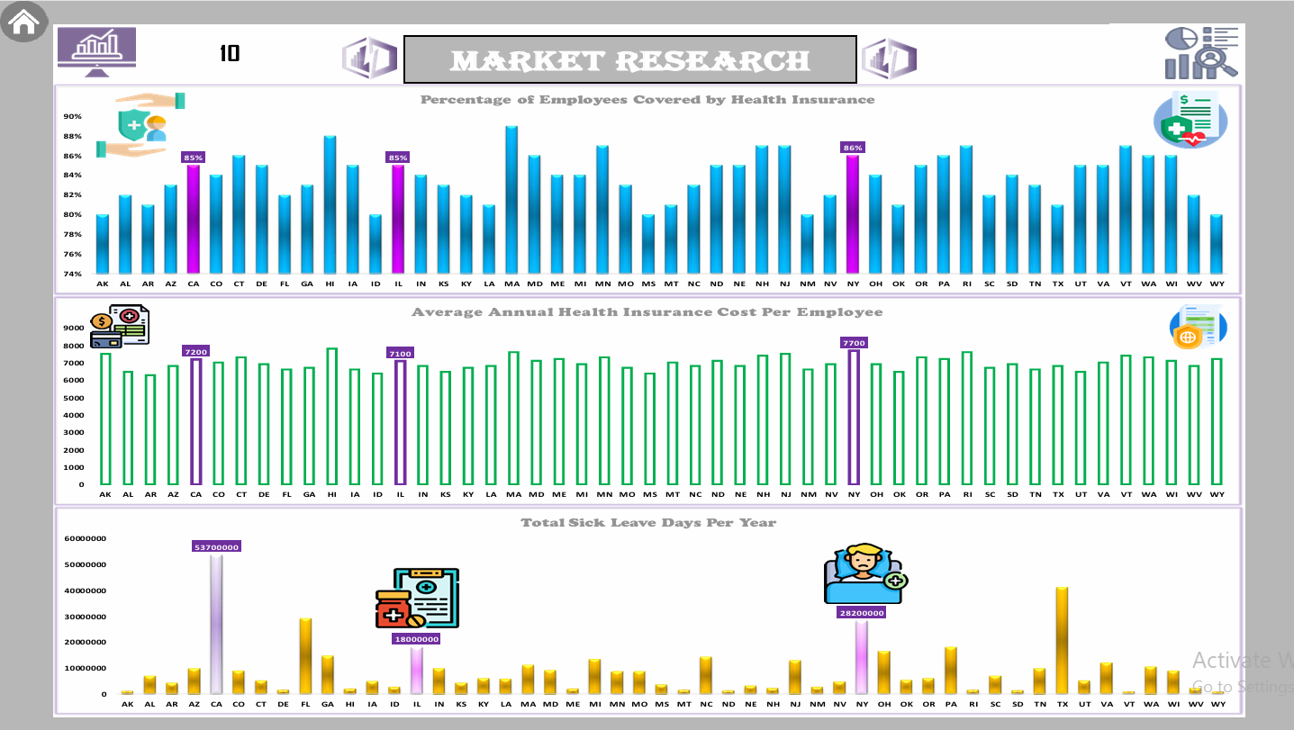

Slide 37
Data Mining

Slide 38
Data Mining Techniques
Clustering
1
2
Classification
Grouping employees based on similar characteristics (e.g., job satisfaction, performance ratings).
Example: Identifying high-risk groups for attrition.
Predicting categorical outcomes (e.g., Will an employee leave? Yes/No).
Example: Attrition prediction using Random Forest Classifier.
Discovering relationships between variables (e.g., Overtime → Attrition).
Example: Employees working overtime are 3x more likely to leave.
Predicting continuous outcomes (e.g., Salary, Tenure).
Example: Salary prediction based on job role and experience.
Association Rule Mining
3
4
Regression Analysis

Slide 39



Data Mining Insights
1. High-Risk Groups for Attrition:
Employees with low salaries and short tenure are at higher risk of leaving.
Employees working overtime are 3x more likely to leave.
2. Performance Trends:
High-performing employees tend to have higher salaries and longer tenure.
Employees with lower performance ratings (3/5) have the highest resignation rates.
3. Training Effectiveness:
Employees who participate in training programs show improved performance and higher promotion rates.
Training participation is positively correlated with job satisfaction.

Slide 40
Data-Driven Decision Making
Recommendations:
Improve work-life balance and reduce overtime.
Enhance compensation and benefits.
Provide clear career paths and training opportunities.
Strengthen diversity and inclusion initiatives.

Slide 41
Data Storage
Platforms Used:
GitHub and Google Drive.
Repository Structure:
Organized by project stages (Data Collection, Data Cleaning, etc.).
Accessibility:
Secure and easily accessible for team members.

Slide 42
Market Research Analysis
Labor Force
Average Annual Salaries
Unemployment Rate
Employment Type
Key states demonstrate strong workforce participation, indicating robust talent availability for strategic hiring initiatives.( like: CA, IL, NY)
Significant regional salary differences emerge, highlighting the importance of market-aligned compensation strategies for talent retention and productivity.
The current tight labor market creates competitive hiring conditions, requiring careful consideration of timing, compensation, and training investments.
The mix of employment arrangements provides valuable insights for optimizing benefits and workforce structure to balance organizational flexibility with operational stability.

Slide 43
Salary Structure
Training & Development
Performance Evaluation
Turnover & Recruitment
Insurance & Benefits
Disparities in minimum and maximum pay reveal equity and skill demand.
Important for compensation strategy and budget planning.
Significant organizational investment in continuous learning programs demonstrates commitment to workforce capability building and future readiness.
Employee retention patterns directly influence recruitment strategies, particularly during periods of business growth or workforce instability.
Supports promotion planning, training needs, and employee engagement.
Absenteeism & Leave
Comprehensive benefits and insurance coverage serve as a competitive advantage in both attracting top talent and improving employee retention.
Indicates job satisfaction and organizational health.
Helps optimize workforce planning.
Total Employees
Reflects business expansion or downsizing.
Aids in resource planning and performance analysis

Slide 44
PESTEL Analysis

Slide 45
P
Political
Government policies on labor laws, wages, insurance, and leave directly impact hiring and compensation.
Political stability and tax policies influence operational costs.
Union influence and potential strikes may affect workforce stability.
Economic
E
Significant variations in compensation levels highlight the need for equitable pay structures.
External economic factors including inflation and currency fluctuations may pressure salary budgets, while overall economic conditions directly shape talent acquisition strategies.
Social
S
Strong employee benefits and work-life balance provisions contribute to workforce satisfaction.
Rising expectations for diversity, flexible work, and career development.
Sick leave policies vary by location and are loosely regulated.

Slide 46
T
Technological
Substantial investments in digital upskilling programs position the workforce for future readiness.
Tools like Power BI and Tableau enhance decision-making.
Automation and cybersecurity are key areas for improvement.
Environmental
E
Remote work can reduce environmental impact from commuting.
Opportunities exist for CSR and eco-friendly initiatives.
New environmental regulations may require office policy updates.
Legal
L
High health insurance coverage shows compliance.
Adherence to labor laws, data privacy, and anti-discrimination regulations is essential.
Regular contract reviews and legal audits are recommended.

Slide 47

SWOT Analysis

Slide 48
THREATS
Intense competition for talent and rising recruitment costs.
Work pressures and new regulations
WEAKNESSES
High turnover and weak incentive programs.
Salary disparities and lack of training opportunities..
STRENGTHS
Competitive salaries and long employee tenure.
High job satisfaction and productivity.
OPPORTUNITIES
Improve training programs and offer remote work.
Leverage technology and expand into new markets.

Slide 49
THREATS
Intense competition for talent and rising recruitment costs.
Work pressures and new regulations
STRENGTHS
WEAKNESSES
High turnover and weak incentive programs.
Salary disparities and lack of training opportunities..
Competitive salaries and long employee tenure.
High job satisfaction and productivity.
OPPORTUNITIES
Improve training programs and offer remote work.
Leverage technology and expand into new markets.

Slide 50
WEAKNESSES
High turnover and weak incentive programs.
Salary disparities and lack of training opportunities..
STRENGTHS
OPPORTUNITIES
Competitive salaries and long employee tenure.
High job satisfaction and productivity.
Improve training programs and offer remote work.
Leverage technology and expand into new markets.
THREATS
Intense competition for talent and rising recruitment costs.
Work pressures and new regulations

Slide 51
WEAKNESSES
High turnover and weak incentive programs.
Salary disparities and lack of training opportunities..
STRENGTHS
THREATS
Intense competition for talent and rising recruitment costs.
Work pressures and new regulations
Competitive salaries and long employee tenure.
High job satisfaction and productivity.
OPPORTUNITIES
Improve training programs and offer remote work.
Leverage technology and expand into new markets.

Slide 52


Slide 53

TWOS ANALYSIS
SO
ST
WO
WT
Develop training programs to enhance skills based on evaluations.
Leverage competitive salaries to attract and retain talent.
Increase travel and job exchange opportunities to improve employee efficiency.
Enhance job stability through long-term incentive policies.
Develop an attractive work environment to reduce external competition for skilled employees.
Improve promotion policies to ensure high-performing employees stay.
Improve financial incentives and rewards to create a more competitive work environment.
Implement sustainable professional development plans to empower employees.
Enhance work-life balance through flexible policies.
Reduce attrition rates through work environment improvements and stress reduction initiatives.
Review recruitment and retention policies to ensure workforce stability.
Introduce psychological support and career counseling programs to reduce job stress and increase productivity.

Slide 54
TWOS ANALYSIS
SO
Develop training programs to enhance skills based on evaluations.
Leverage competitive salaries to attract and retain talent.
Increase travel and job exchange opportunities to improve employee efficiency.
ST
WO
WT
Enhance job stability through long-term incentive policies.
Develop an attractive work environment to reduce external competition for skilled employees.
Improve promotion policies to ensure high-performing employees stay.
Improve financial incentives and rewards to create a more competitive work environment.
Implement sustainable professional development plans to empower employees.
Enhance work-life balance through flexible policies.
Reduce attrition rates through work environment improvements and stress reduction initiatives.
Review recruitment and retention policies to ensure workforce stability.
Introduce psychological support and career counseling programs to reduce job stress and increase productivity.

Slide 55
TWOS ANALYSIS
SO
ST
Develop training programs to enhance skills based on evaluations.
Leverage competitive salaries to attract and retain talent.
Increase travel and job exchange opportunities to improve employee efficiency.
Enhance job stability through long-term incentive policies.
Develop an attractive work environment to reduce external competition for skilled employees.
Improve promotion policies to ensure high-performing employees stay.
WO
WT
Improve financial incentives and rewards to create a more competitive work environment.
Implement sustainable professional development plans to empower employees.
Enhance work-life balance through flexible policies.
Reduce attrition rates through work environment improvements and stress reduction initiatives.
Review recruitment and retention policies to ensure workforce stability.
Introduce psychological support and career counseling programs to reduce job stress and increase productivity.

Slide 56
TWOS ANALYSIS
SO
ST
WO
Develop training programs to enhance skills based on evaluations.
Leverage competitive salaries to attract and retain talent.
Increase travel and job exchange opportunities to improve employee efficiency.
Enhance job stability through long-term incentive policies.
Develop an attractive work environment to reduce external competition for skilled employees.
Improve promotion policies to ensure high-performing employees stay.
Improve financial incentives and rewards to create a more competitive work environment.
Implement sustainable professional development plans to empower employees.
Enhance work-life balance through flexible policies.
WT
Reduce attrition rates through work environment improvements and stress reduction initiatives.
Review recruitment and retention policies to ensure workforce stability.
Introduce psychological support and career counseling programs to reduce job stress and increase productivity.

Slide 57
TWOS ANALYSIS
SO
ST
WO
WT
Develop training programs to enhance skills based on evaluations.
Leverage competitive salaries to attract and retain talent.
Increase travel and job exchange opportunities to improve employee efficiency.
Enhance job stability through long-term incentive policies.
Develop an attractive work environment to reduce external competition for skilled employees.
Improve promotion policies to ensure high-performing employees stay.
Improve financial incentives and rewards to create a more competitive work environment.
Implement sustainable professional development plans to empower employees.
Enhance work-life balance through flexible policies.
Reduce attrition rates through work environment improvements and stress reduction initiatives.
Review recruitment and retention policies to ensure workforce stability.
Introduce psychological support and career counseling programs to reduce job stress and increase productivity.

Slide 58


Slide 59
Strengths
Results
SOAR ANALYSIS
Opportunities
Aspirations

Slide 60
Opportunities
Strengths
High Workforce Satisfaction: Strong employee approval of workplace relationships and organizational culture.
Sustainable Work-Life Integration: Established policies supporting employee well-being and balance.
Talent Retention Edge: Competitive compensation packages and lower turnover rates than industry peers.
Results
SOAR ANALYSIS
Aspirations

Slide 61
Opportunities
Enhance training programs and attract young talent.
Use performance analytics and expand job benefits.
Results
SOAR ANALYSIS
Strengths
Aspirations

Slide 62
Aspirations
Become a regional leader in flexible work innovation
Prioritize internal talent growth and decision-making
Opportunities
SOAR ANALYSIS
Results
Strengths

Slide 63
Results
Improved employee retention and skill development
Streamlined HR processes through tech adoption
Aspirations
SOAR ANALYSIS
Opportunities
Strengths

Slide 64
VRIO Analysis
1) Value:
High-performing employees, strong training programs, and job satisfaction contribute to valuable human capital.
2) Rarity:
Specialized expertise, multilingual talent, and technical proficiency create differentiation.
3) Imitability:
Internal training programs and learning culture are hard to replicate.
Significant investment in employee development increases uniqueness.
4) Organization:
Stable teams, effective HR strategies, and low attrition ensure alignment with business goals.

Slide 65
Conclusion
Summary of Insights:
The company has valuable and rare human resources with strong training programs.
High turnover and work-life balance issues need addressing.
Predictive models and strategic recommendations can improve retention and performance.
Next Steps:
Implement recommended strategies to improve retention and performance.
Continuously monitor workforce trends and adjust policies as needed.

Slide 66
Any Question?

Slide 67
THANKS!

